Slide 1

Mortality Prediction Assessment
Problem to predict the output based upon Heart Rate & Lifestyle

Slide 2
Hypothesis Definition
Data Definition
Dataset has 23 attributes monitored
from hospitals
Problem Statement
Predict Mortality caused by heart failure
Target Variable
Mortality – 0 = died & 1 = Alive
Problem Type
Binary Classification

Slide 3
Process Involved
Data Loading
Feature Analysis
Feature Selection
Feature Sampling
Model Building

Slide 4
Data Loading
Raw Data Loaded On Pandas data frame
Checking for overall data information
Data Columns where badly named, hence were renamed appropriately

Slide 5
Feature Engineering
Feature Selection
Run a Pandas Profiling
Univariate variable analysis
Feature Encoding
Data Was splitted into X & Y based on the target variable
Label Encoder has been used as a feature encoder for categorical variables.
Feature Validation
Correlation value Check
Recursive Feature Elimination Techniques were used.
Identification of imbalance variables

Slide 6
Feature Engineering(Contd)
Following is the table that depicts the values dropped:
Variables | Correlation | Imbalance
Hemoglobin | Very High (almost 1) | Not Much
Lifestyle | Medium | Yes
Depression | Very High | Very High

Slide 7

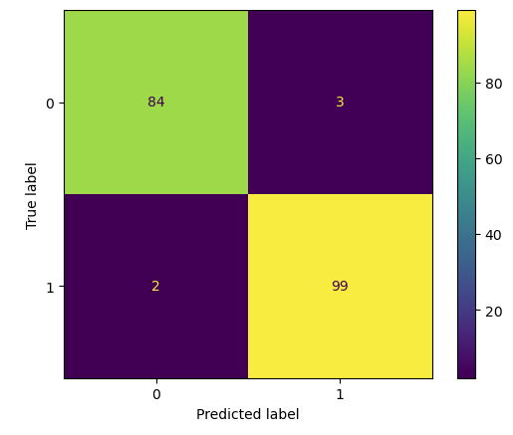
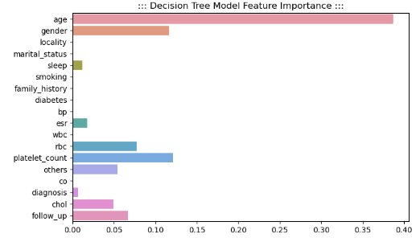
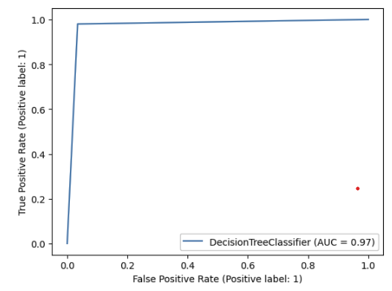
Model Train/Test
Feature Importance of the Model
Plotting of the Confusion Matrix
Plotting of the ROC Curve
for Model Stability

